Slide 1
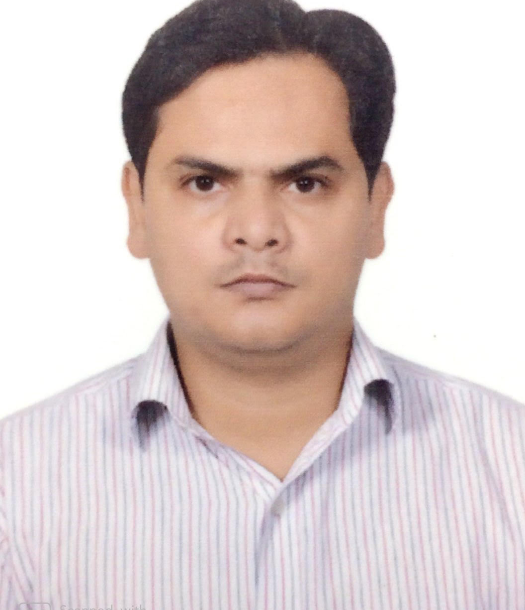
Lead Developer
Ram Prakash Singh
Lead Developer
ram.prakash.singh@accenture.com
+91 9953875097
Fulfillment Service- Adidas
Delivery lead for Ecommerce microservice based application for scrum team. Tech stack such as Java, SpringBoot, Reactive Programming using SpringWebFlux, Redis, Postgres db, Docker, Kubernetes, Jenkins, Junit, Sonar.
Taxation – Adidas
Lead developer for Ecommerce microservice based application for scrum team. Tech stack such as Java, SpringBoot, Reactive Programming using SpringWebFlux, Junit.
Business On Line(Corporate banking) – Bank Of Ireland Client. Location: Ireland.
Delivery lead for Corporate Banking web application for scrum team. Agile software develoment methodology. Tech stack such as Java, Spring, Oracle, Coolgen, Mainframe.
Machine to Machine – Yanmar Agriculture Equipment Client . Location: Japan & India.
Delivery lead for Cloud based application for scrum team. Agile software development methodology. Tech stack Java, AWS, Docker, Junit, Sonar.
11 years experience in design and implementation of web application, object oriented, frameworks & cloud architecture in various business domains. Experienced in managing, leading development & integration projects, test and business driven development, product development.
Experienced in microservices, monolithic, Java, Reactive programming, AWS, Docker, Kafka, Redis, SAML applications, open-source technologies such as spring/spring boot/Spring Web Flux, Hibernate, JPA, application servers, version control, build and deployment tools, SQL/NO-SQL databases, UI(JavaScript) tech stack.
Java
SpringWebFlux
SpringBoot
REST
Microservice
SOAP
Hibernate
AWS(Lambda, IOT, Kinesis, S3, Dynamo & Aurora DB, API gatway, CI/CD etc)
Docker
Redis
Kafka
SQL/No-SQL DB
Selenium
Junit
Ecommerce
Retail
Banking & Mortgage Insurance
Manufacturing(AWS IOT)

